Slide 1
Git Learn
From the scratch
Prepared By:
Mir Arif Hasan
B. Sc in CSE at AUST, BD
Email: arif.ishan05@gmail.com

Slide 2
Topics
Introduction of Git & GitHub
Why Git?
Git configuration
Creating repository, Init, Remote add, Clone
Git file status
Git Add, Commit, Ammand, Log, Push, Pull
Branching, Checkout
Merge, Conflicts
Collaboration
Pull request

Slide 3
Introduction of Git & GitHub
Git:
Git is a version control system
You can manage your files version through Git
Gives the scope for open source development
Anyone can update your public repo and request you to add them
GitHub:
GitHub is a server where the files are stored

Slide 4
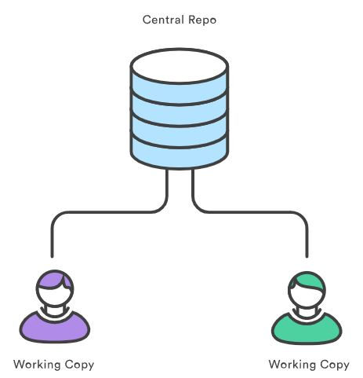
Why Git?
Git is a distributed version control system

Slide 5
Git Configuration
Download & install Git software
Open git bash command to configure
Write below commands:
git config --global user.name “<your username>”
git config --global user.email <your email>
You can see/test by
git config user.name
git config user.email
Or, git config --list
*See next page example

Slide 6
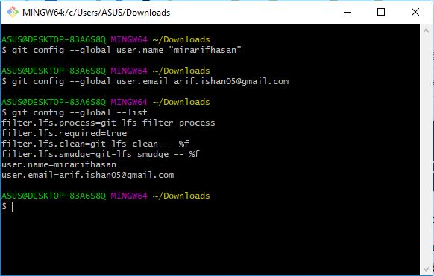
Git Configuration

Slide 7
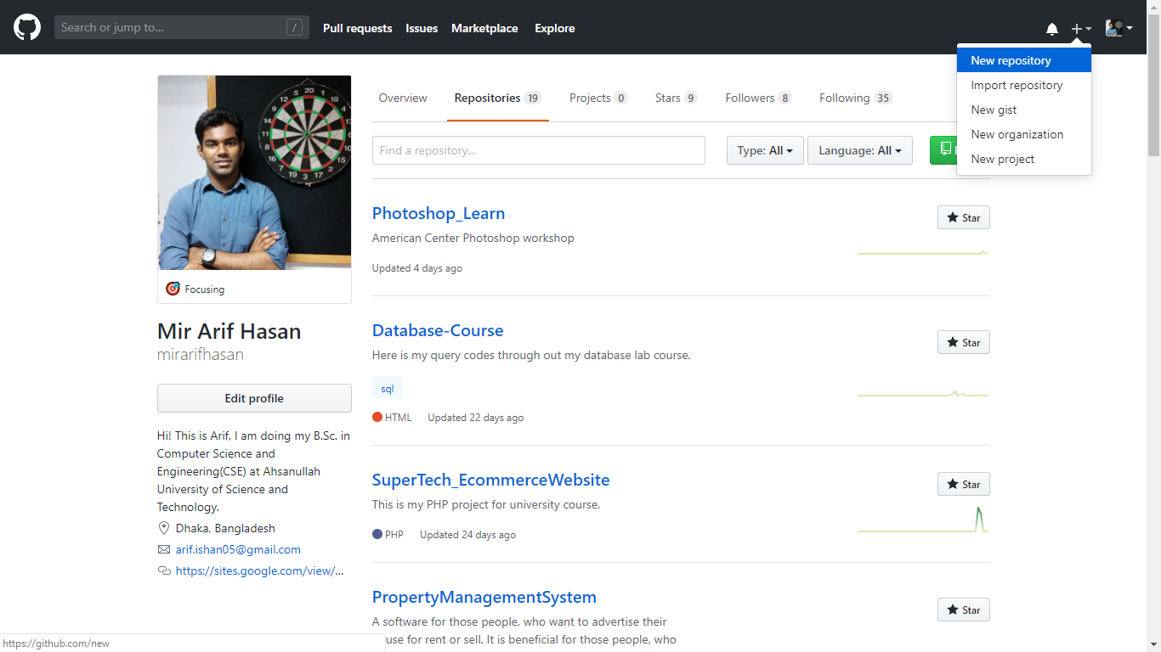
Create Repository

Slide 8
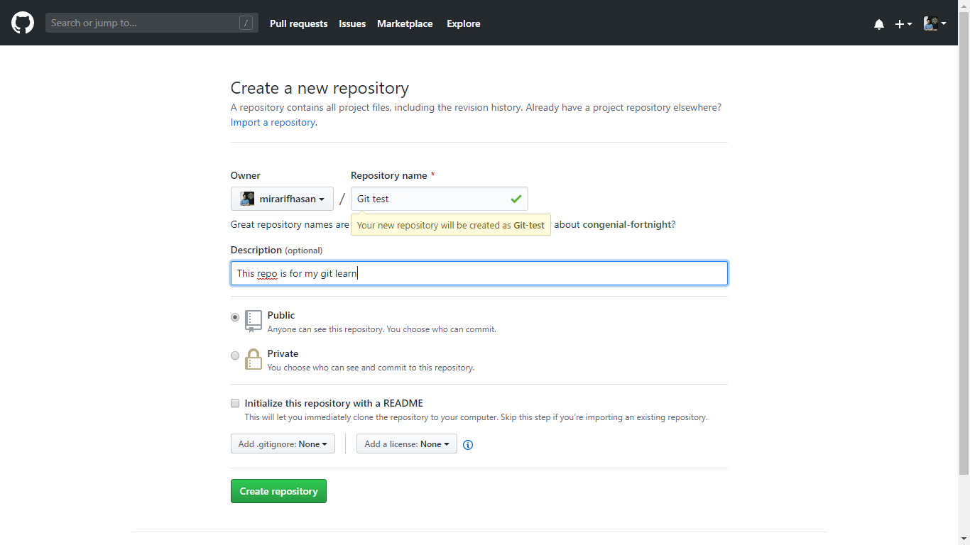
Create Repository
If select public, anybody can see your repository

Slide 9
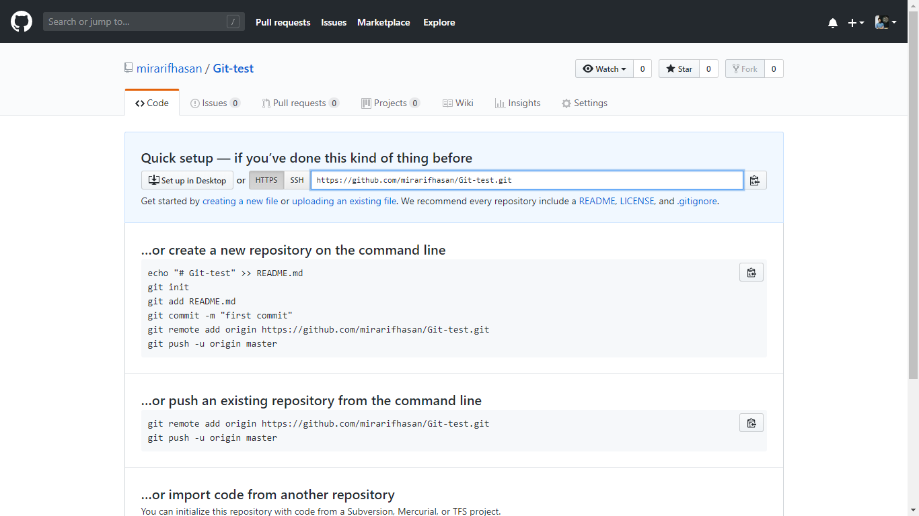
Create Repository
Copy the HTTP link

Slide 10
Link your repository with local
Clone
[If you have not create any project on your local server]
Two way to link up
Remote add
[If you already started with your project locally, but you have a new repository]
NB: If you both work on your local and have a old repository, then you should go “Remote add” then “git pull origin <branch>” and resolve conflicts(if need).

Slide 11
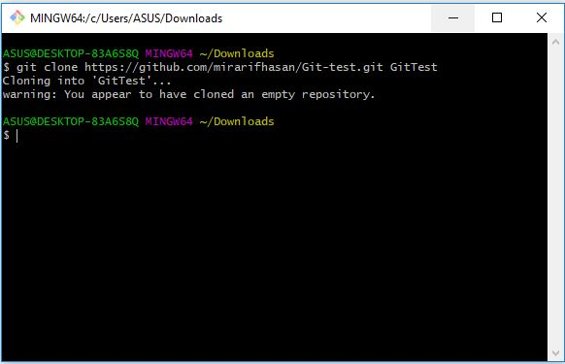
Git Clone
Use any command:
git clone <HTTP link>
git clone <HTTP link> <directory>
You can think ‘clone’ like ‘download’.
Where you open git bash and apply 1st cmd, there the repo will be download.
Otherwise, there create a directory then, it will download in the directory.

Slide 12
Remote Add
Step 1:
Go to your project folder.
Step 2:
Use command: “git init”
Explanation: For initialize git on that folder
Step 3:
Use command: “git remote add origin <repo url>”
Explanation: For link with remote repository
Step 4: (Optional)
Use command: “git pull origin <branch_name>”
Explanation: If your remote repo is not blank repo.

Slide 13
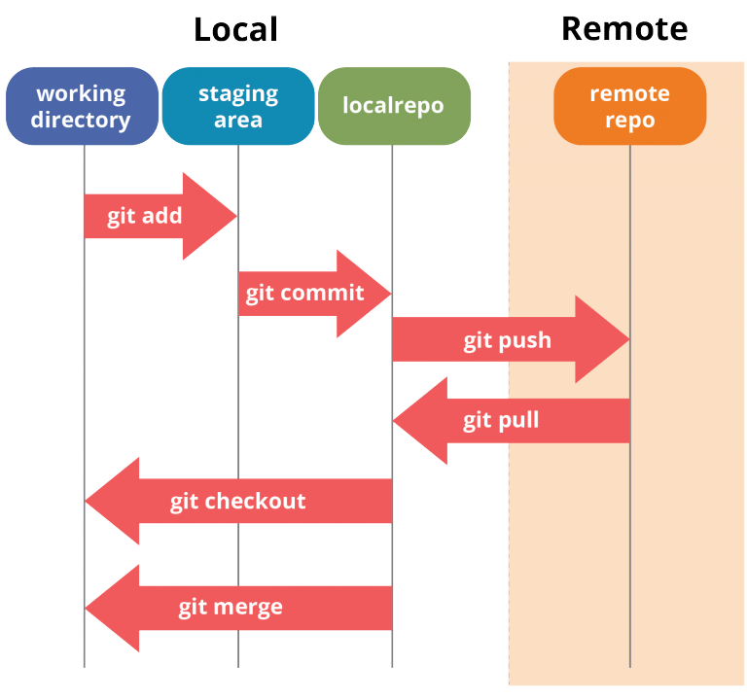
Git Commands
Local Server - Your PC
Remote Server - GitHub / Cloud
When we init/clone, a ‘.git’ hidden file generates to track our files and other data.
git status - Gives the overview of files
git add - Adding file for commit
git commit - Saving for upload/push
git push - Uploading to remote server
git stash - Saving temporary without commit
git pull - Bringing the change from remote to local
git branch - See a list of branch
git checkout - Changing branch

Slide 14
Git Commands [Regularly used]
Command 1: “git status”
Explanation: Gives a list of files which are modified, untract etc. You can use this cmd in any stage.
Command 2: “git add <file name>” or “git add . ”
Explanation: Now you have to select files for the next commit.
Command 3: “git commit -m ‘<comment>’”
Explanation: You are saving your changes by committing. You should pass a comment about what features add or bug fixed.
Command 4: “git push -u origin master” or “git push -u origin <branch_name>”
Explanation: To upload your project in remote. You have to mention branch name in command.
Command 5: “git pull origin master” or “git pull origin <branch_name>”
Explanation: This command is for getting all updates from remote to local. Updates will come from the branch you add in command.

Slide 15
Conflicts
By ‘pull’ command one can fetch remotes code and the merge can be done.
Multiple developer working on a same projects. When developer wanted to marge his changes with remote code, git automatically merge his codes. Sometimes git could not merge. That situation is called conflicts.
If conflict arise, you can resolve it manually. [by this, you can take both remote and local codes]
If you want to keep remotes code, then: git checkout --theirs--
If you want to keep your code, then: git checkout --ours--

Slide 16
Branch
login.java
login.java
checkout
push
checkout
pull & push
Master
Master
login.java
master
signup
login
checkout
pull & push
Master
checkout
pull & push
signUp.java

Slide 17
Branch & Checkout
List of local branches: git branch
List of remote branches: git branch -r
List of all branches: git branch -a
Create a branch: git branch <branch_name>
Switching to another branch: git checkout <destination_branch_name>
Create and switch: git checkout -b <destination_branch_name>
Create a new branch with a remote branch history: git checkout <branch> <remote/branch>
Delete a branch: git branch -D <branch_name>

Slide 18
Stash Commands
Stash is use for saving files temporary. When you not willing to commit, you can use the stash command.
git stash save ‘<message>’ or git stash save
Seeing the list of stash: git stash list
Adding the stash files/changes: git stash apply
By default, this command will apply the last stashed files
Adding a specific stash files/changes: git stash apply <stash@{no.}>
Delete a specific stash files/changes: git stash drop <stash@{no.}>
Apply and delete last stash: git stash pop
Apply and delete a specific stash: git stash pop <stash@{no.}>

Slide 19
Cherry-Pick & Revert
Cherry-Pick
When you want to take the changes from another branch commit to your branch, then you have to use bellow cmd,
git cherry-pick <source commit hash>
Revert
When you want to remove changes from a specific commits,
git revert <commit_hash>

Slide 20
Some Basic Commands
To see the number files and folder: ls -l
To see all files and folder: ls -la
To print file on git bash: cat <file_name>
To visit a directory: cd <directory_name>/
Seeing the remote origin: git remote -v
To create a file: echo ‘<content>’ > <file_name_with_extension>
Seeing the changes with last commit: git diff
Seeing the changes on a specific commit: git log -p <commit_hash>
Changing save with the previous commit: git commit --amend -m ‘<message>’
To clear git cmd GUI: clear
For stop current execution: ctrl + c

Slide 21
Thank You

